Slide 1
CSE 486/586 Distributed Systems Socket Programming and Android
Steve Ko
Computer Sciences and Engineering
University at Buffalo

Slide 2
Last Time
What to put on top of physical networks?
Layers providing survivability
Where to put functionalities?
Fate-sharing & end-to-end arguments
IP layer doesn’t provide much
TCP handles most of the survivability issues
TCP & UDP: the two transport protocols of the Internet
What interface do applications see?
Socket API

Slide 3
Today
Today: background for programming assignments
Socket programming, Android, and project overviews
It’s imperative that you try yourself!
If you have no clue at the end of the lecture, please stop by my office.
Goal: today’s really about transferring basic knowledge, less about design decisions.

Slide 4
Today’s Question
TCP provides a reliable, byte-stream connection as an abstraction.
UDP gives raw access to what the IP network provides without all the overhead of TCP.
So, how do we program applications on top of these abstractions?

Slide 5


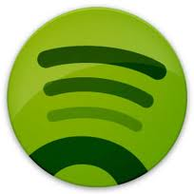

What Applications See
App
Socket API
TCP
UDP
OS
IP
Device Drivers
Network Interface

Slide 6
UNIX Socket API
Socket interface
Originally provided in Berkeley UNIX
Later adopted by all popular operating systems
Simplifies porting applications to different OSes
In UNIX, everything is like a file
All input is like reading a file
All output is like writing a file
File is represented by an integer file descriptor
API implemented as system calls
E.g., socket(), connect(), listen(), read(), write(), close(), …
Will look at the details of these system calls

Slide 7


So, Let’s Consider a Scenario
What is the server address?
IP address
How do we identify the Web server?
Port number
Socket API
Socket API
OS
OS
IP network

Slide 8
Using Ports to Identify Services
Server host 128.2.194.242
Service request for
128.2.194.242:80
(i.e., the Web server)
Client host
Web server
(port 80)
Client
OS
Echo server
(port 7)
Service request for
128.2.194.242:7
(i.e., the echo server)
Web server
(port 80)
Client
OS
Echo server
(port 7)

Slide 9
Knowing What Port Number To Use
Popular applications have well-known ports
E.g., port 80 for Web and port 25 for e-mail
See http://www.iana.org/assignments/port-numbers
Well-known vs. ephemeral ports
Server has a well-known port (e.g., port 80)
Between 0 and 1023
Client picks an unused ephemeral (i.e., temporary) port
Between 1024 and 65535
Uniquely identifying the traffic between the hosts
Two IP addresses and two port numbers
Underlying transport protocol (e.g., TCP or UDP)

Slide 10
Typical Client Program
E.g. browser
Prepare to communicate
Create a socket
Determine server IP address and port number (e.g., for a Web server)
Initiate the connection to the server
Exchange data with the server
Write data to the socket
Read data from the socket
Do stuff with the data (e.g., render a Web page)
Close the socket

Slide 11
Servers Differ From Clients
Passive open
Prepare to accept connections
… but don’t actually establish
… until hearing from a client
Hearing from multiple clients
Allowing a backlog of waiting clients
... in case several try to communicate at once
Create a socket for each client
Upon accepting a new client
… create a new socket for the communication

Slide 12
Typical Server Program
E.g., a Web server
Prepare to communicate
Create a socket
Associate local address and port with the socket
Wait to hear from a client (passive open)
Indicate how many clients-in-waiting to permit
Accept an incoming connection from a client
Exchange data with the client over new socket
Receive data from the socket
Do stuff to handle the request (e.g., get a file)
Send data to the socket
Close the socket
Repeat with the next connection request

Slide 13
Putting it All Together
Server
socket()
bind()
Client
listen()
socket()
establish
connection
accept()
connect()
block
send request
write()
read()
process
request
send response
write()
read()

Slide 14
Client Creating a Socket: socket()
Client
Operation to create a socket
int socket(int domain, int type, int protocol)
Returns a descriptor (or handle) for the socket
Originally designed to support any protocol suite
Domain: protocol family
PF_INET for the Internet
Type: semantics of the communication
SOCK_STREAM: reliable byte stream
SOCK_DGRAM: message-oriented service
Protocol: specific protocol
UNSPEC: unspecified
(PF_INET and SOCK_STREAM already implies TCP)
socket()
connect()
write()
read()

Slide 15
Client: Learning Server Address/Port
Server typically known by name and service
E.g., “www.cnn.com” and “http”
Need to translate into IP address and port #
E.g., “64.236.16.20” and “80”
Translating the server’s name to an address
struct hostent *gethostbyname(char *name)
Argument: host name (e.g., “www.cnn.com”)
Returns a structure that includes the host address
Identifying the service’s port number
struct servent *getservbyname(char *name, char *proto)
Arguments: service (e.g., “ftp”) and protocol (e.g., “tcp”)

Slide 16
Client: Connecting Socket to the Server
Client contacts the server to establish connection
Associate the socket with the server address/port
Acquire a local port number (assigned by the OS)
Request connection to server, who will hopefully accept
Establishing the connection
int connect(int sockfd, struct sockaddr *server_address, socketlen_t addrlen)
Arguments: socket descriptor, server address, and address size
Returns 0 on success, and -1 if an error occurs
Client
socket()
connect()
write()
read()

Slide 17
Client: Sending and Receiving Data
Sending data
ssize_t write(int sockfd, void *buf, size_t len)
Arguments: socket descriptor, pointer to buffer of data to send, and length of the buffer
Returns the number of characters written, and -1 on error
Receiving data
ssize_t read(int sockfd, void *buf, size_t len)
Arguments: socket descriptor, pointer to buffer to place the data, size of the buffer
Returns the number of characters read (where 0 implies “end of file”), and -1 on error
Closing the socket
int close(int sockfd)
Client
socket()
connect()
write()
read()

Slide 18
Server: Server Preparing its Socket
Server creates a socket and binds address/port
Server creates a socket, just like the client does
Server associates the socket with the port number (and hopefully no other process is already using it!)
Create a socket
int socket(int domain, int type, int protocol)
Bind socket to the local address and port number
int bind (int sockfd, struct sockaddr *my_addr, socklen_t addrlen)
Arguments: socket descriptor, server address, address length
Returns 0 on success, and -1 if an error occurs
Server
socket()
bind()
listen()
accept()

Slide 19
Server: Allowing Clients to Wait
Many client requests may arrive
Server cannot handle them all at the same time
Server could reject the requests, or let them wait
Define how many connections can be pending
int listen(int sockfd, int backlog)
Arguments: socket descriptor and acceptable backlog
Returns a 0 on success, and -1 on error
What if too many clients arrive?
Some requests don’t get through
The Internet makes no promises…
And the client can always try again
Server
socket()
bind()
listen()
accept()

Slide 20
Server: Accepting Client Connection
Now all the server can do is wait…
Waits for connection request to arrive
Blocking until the request arrives
And then accepting the new request
Accept a new connection from a client
int accept(int sockfd, struct sockaddr *addr, socketlen_t *addrlen)
Arguments: socket descriptor, structure that will provide client address and port, and length of the structure
Returns descriptor for a new socket for this connection
Server
socket()
bind()
listen()
accept()

Slide 21
Client and Server: Cleaning House
Once the connection is open
Both sides and read and write
Two unidirectional streams of data
In practice, client writes first, and server reads
… then server writes, and client reads, and so on
Closing down the connection
Either side can close the connection
… using the close() system call
What about the data still “in flight”
Data in flight still reaches the other end
So, server can close() before client finishing reading

Slide 22
One Annoying Thing: Byte Order
Hosts differ in how they store data
E.g., four-byte number (byte3, byte2, byte1, byte0)
Little endian (“little end comes first”) ← Intel PCs!!!
Low-order byte stored at the lowest memory location
Byte0, byte1, byte2, byte3
Big endian (“big end comes first”)
High-order byte stored at lowest memory location
Byte3, byte2, byte1, byte 0
Makes it more difficult to write portable code
Client may be big or little endian machine
Server may be big or little endian machine

Slide 23
IP is Big Endian
But, what byte order is used “on the wire”
That is, what do the network protocol use?
The Internet Protocols picked one convention
IP is big endian (aka “network byte order”)
Writing portable code require conversion
Use htons() and htonl() to convert to network byte order
Use ntohs() and ntohl() to convert to host order
Hides details of what kind of machine you’re on
Use the system calls when sending/receiving data structures longer than one byte
Notes:
htons == host to network (short)
htonl == host to network (long)
ntohs == network to host (short)
ntohl == network to host (long)

Slide 24
CSE 486/586 Administrivia
Recitations will begin from next Monday.
Will mainly cover project 0
Project 0 description will be out today.
Will talk about this more at the end of the lecture today
Will use the submit script
The deadline is 2/6/12 (Monday).
Please use Piazza; all announcements will go there.
If you want an invite, let me know.
Please come to my office during the office hours!
Give feedback about the class, ask questions, etc.

Slide 25
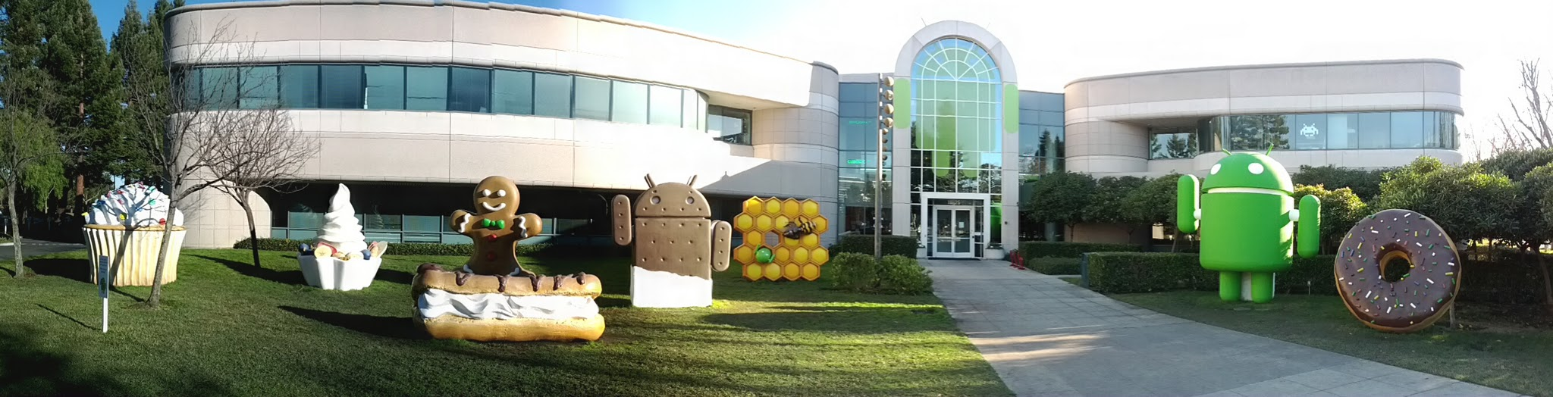
Android
Android is a software stack for mobile devices that includes an operating system, middleware and key applications.
The Android SDK provides the tools and APIs necessary to begin developing applications on the Android platform using the Java programming language.

Slide 26
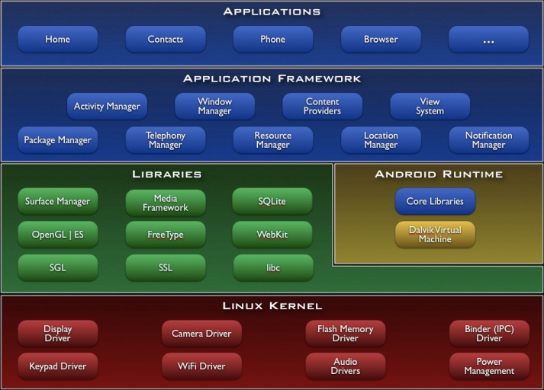
Android Architecture

Slide 27
Android Programming
Using the Android APIs and implementing your logic
Android expects programmers to write their code in the “Android way”.
You need to implement application building blocks defined by Android.
Your logic will be largely event-driven: reaction to something happened, e.g., a button touch, a received message, etc.
A lot of the times, you’ll struggle with the APIs.
It’s necessary to learn how to navigate the API documents and how to quickly find the APIs yourself!
One of the goals of this course
It’s a necessary skill to learn for any other programming you will do in the future.

Slide 28
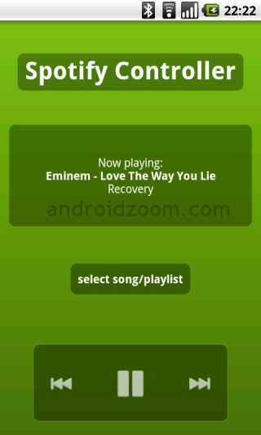
Application Building Blocks
Activities: an activity is a single screen with a user interface.
Subclass of android.app.Activity

Slide 29
Application Building Blocks
Services: a service runs in the background with no UI for long-running operations.
Playing music, sending/receiving network messages, …
Subclass of android.app.Service
Content providers: a content provider manages a shared set of application data.
Provides a customized storage beyond what Android provides (e.g., contacts, calendar, …)
Subclass of android.content.ContentProvider
Broadcast receivers: a broadcast receiver responds to system-wide broadcast announcements.
Screen off, battery low, picture captured, …
Subclass of android.content.BroadcastReceiver

Slide 30
Communication
Intent: building blocks communicate through it.
android.content.Intent
Intent
public class PlayService extends Service {
….
}

Slide 31
Application Registration
AndroidManifest.xml file (the "manifest" file) defines a number of things about the application. Mainly,
Components (activity, service, etc.)
Permission
Letting the system know about the application
<?xml version="1.0" encoding="utf-8"?>
<manifest ... >
<application android:icon="@drawable/app_icon.png" ... >
<activity android:name="com.example.project.ExampleActivity"
android:label="@string/example_label" ... >
</activity>
...
</application>
</manifest>

Slide 32
Project 0
A simple messenger program
Two android devices (emulators) sending messages to each other
Official project description will be out today.
Step 1: Installation (Eclipse & Android SDK)
Use 4.0.3 (API 15)
Step 2: Android Dev Guide
http://developer.android.com/guide/index.html
Read “Android Basics”
Read “Actitivies” & “Services” under “Framework Topics”
Step 3: Tutorials from Android Developers
Minimum: HelloWorld & HelloViews
Step 4: Messenger

Slide 33
Project 0
Messenger
A user of one device should be able to write a message to the other device.
The other device should be able to display what was received.
And vice versa.
You need to use the socket API (PF_INET & SOCK_STREAM, i.e., TCP).
Design document
What components you designed and what they do
Difficulties you faced (what things took time to figure out, …)
(Rough) # of hours you put

Slide 34
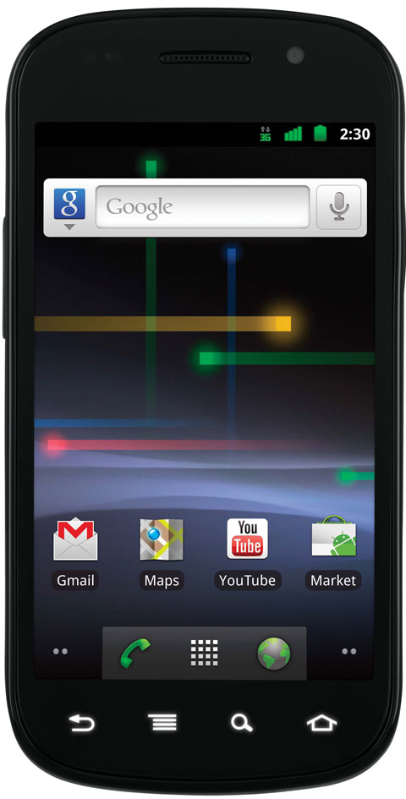
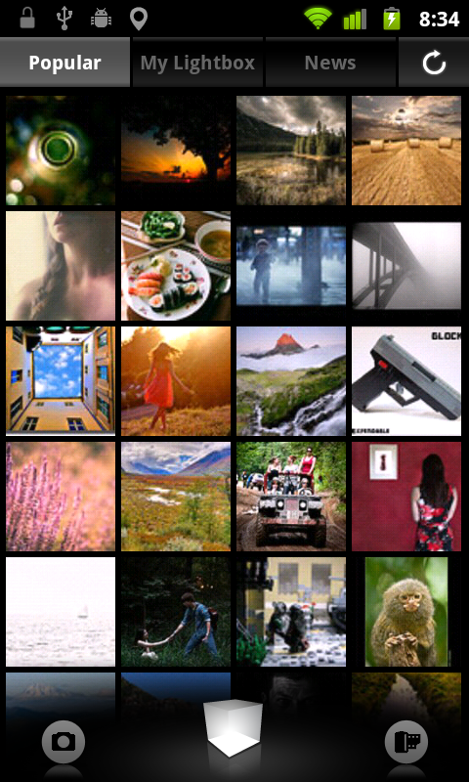
Brief Overview: Project 1 ~ Project 3
Distributed key-value store on Android in 3 steps
A stripped-down version of Amazon’s Dynamo, a backend storage for Amazon’s services
Key: vacation_photo, Value: vacation.jpg

Slide 35
Acknowledgements
These slides contain material developed and copyrighted by
Indranil Gupta at UIUC
Mike Freedman and Jen Rexford at Princeton

